Slide 1

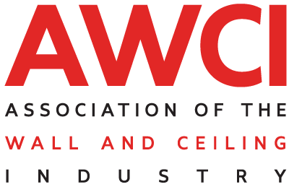

Slide 2
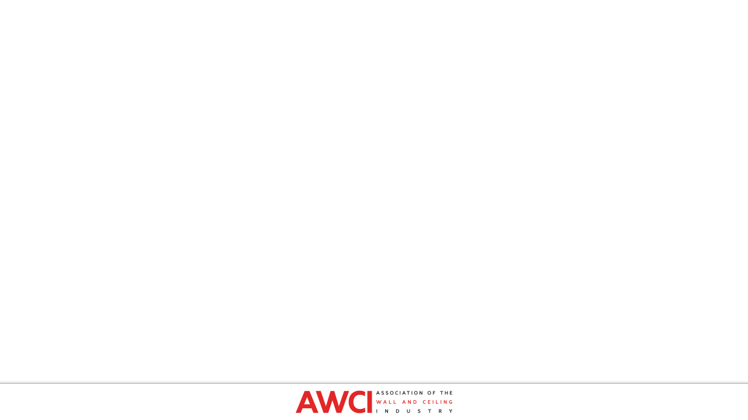

There are three categories of certificates:
    Mechanic
    Industry Professional
    Inspector
There are 13 modules for mechanics and 17 modules for industry professionals and inspectors.
Participants can study and review the course information at their own pace.
The online course is available in English and Spanish for EIFS Mechanics and EIFS Industry Professionals.

Slide 3
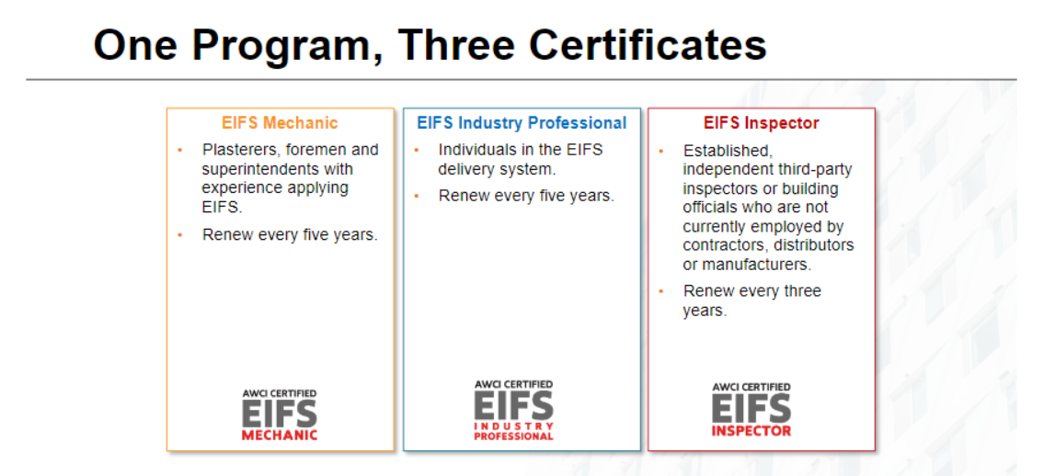
520 CEM
573 CEP
260 CEI
Total: 1353

Slide 4
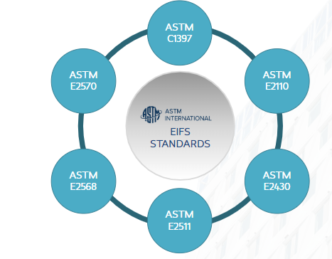
Purpose of the course:
To cover essential knowledge and techniques for correct EIFS installations and proper inspections.
  It is based on best practices and industry-accepted standards, primarily ASTM C1397.
  It is not intended to replace physical on-the-job training or wet wall instruction, nor is it designed to teach inspection of existing residential construction or forensic material.

Slide 5
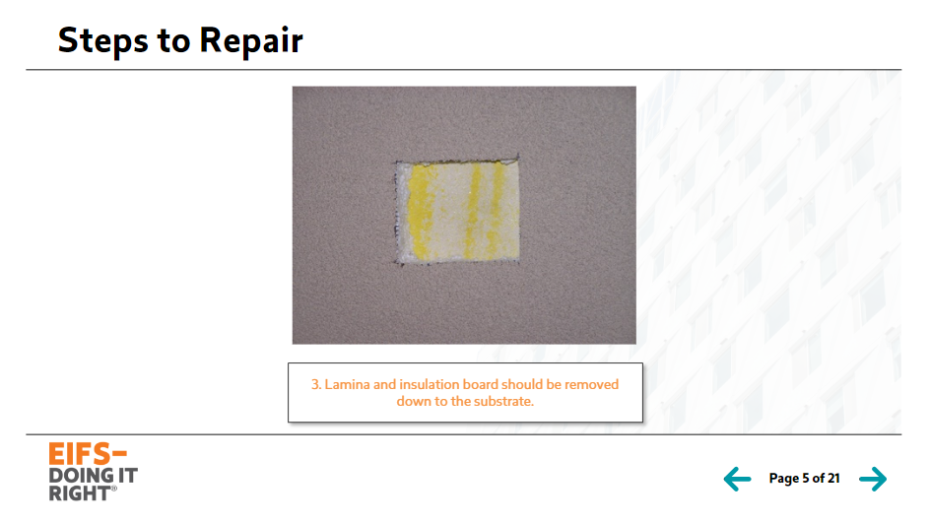
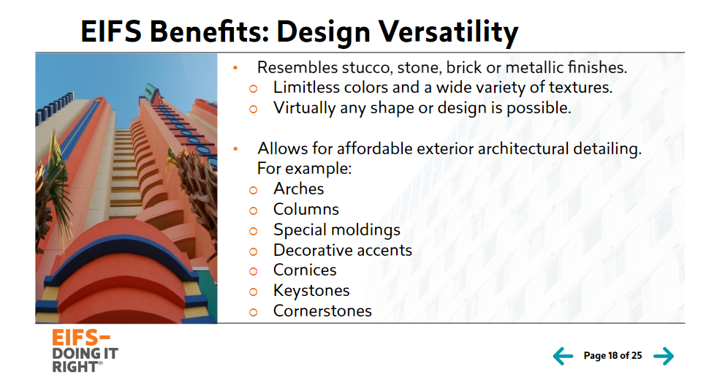
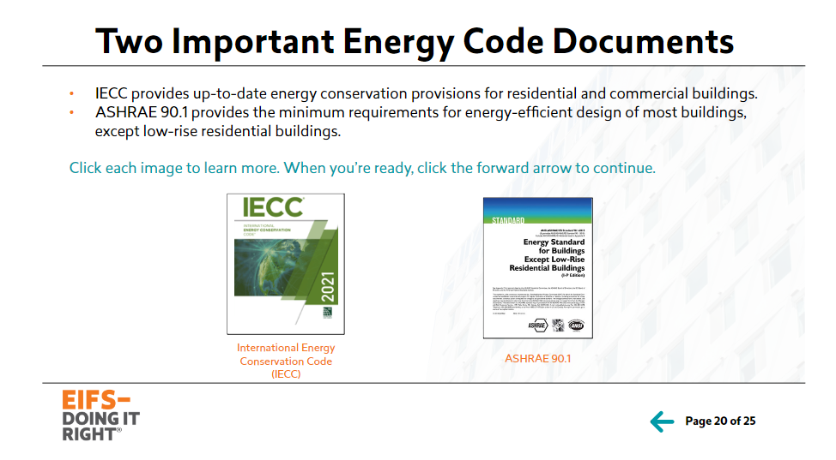
Members Asked, We Answered
  Arranged the course material in a sequence that matches typical project requirements.
  Provided more information on EIFS repair.
  Addressed water-resistive barrier issues with different and new systems.
  Updated current code requirements.

Slide 6

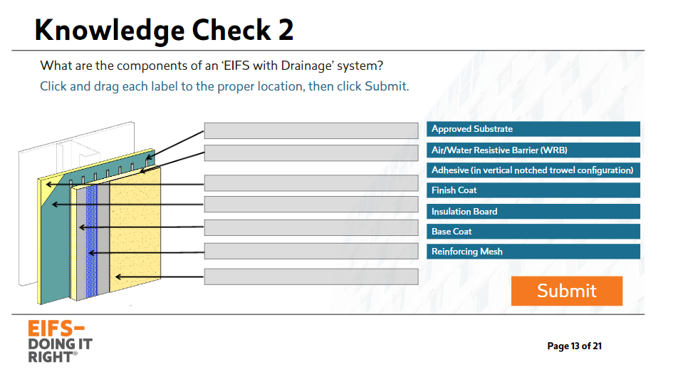
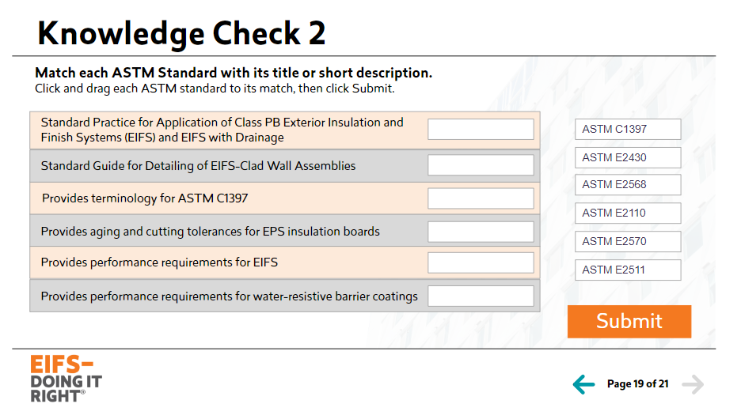
New Edition, New Experience
  Updated content and images to reflect current industry standards
  Upgraded learner experience interface and incorporated interactive knowledge checks
  Optimized ratio to widescreen (16:9) for enhanced mobile and tablet compatibility
  Implemented current instructional design to leverage adult learning best practices

Slide 7
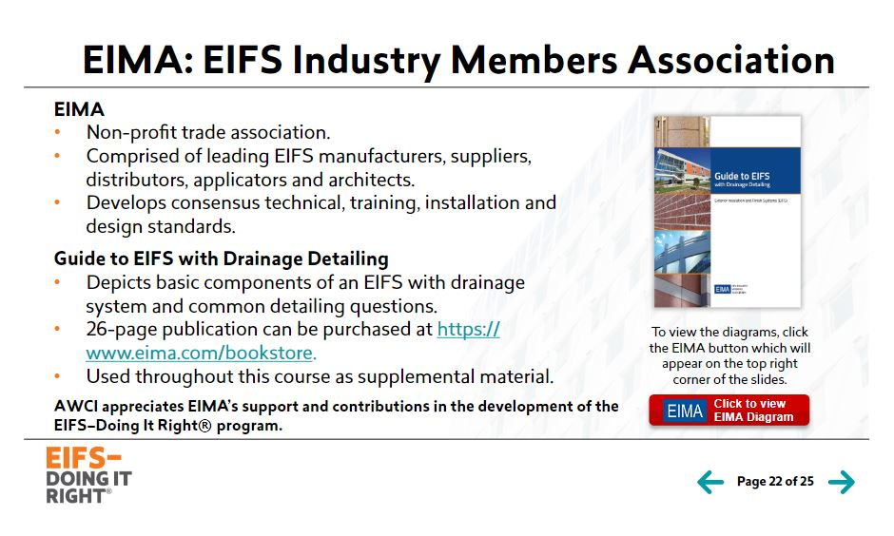
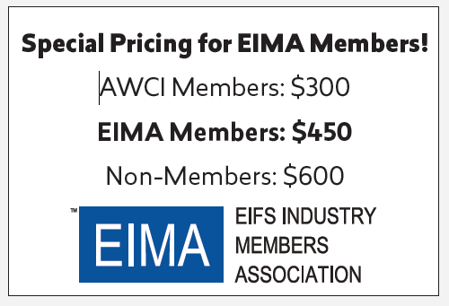

Slide 8
Subject Matter Experts
Mike Chaney, James River Stucco, Inc.
Peter Harrison, Parex
Tim Nelson, OPCMIA
Dave O’Neal, Tremco CPG Inc.
Bryan Stanley, Technical Services Information Bureau
Al Zabbo, Tremco CPG Inc.

Slide 9


EIFS–Doing It Right®
Second Edition
English & Spanish
Available Now

